Slide 1
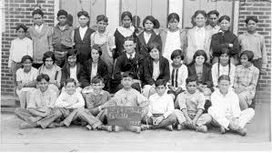
Lyndon Baines Johnson (LBJ)
Taught segregated Mexican-American Students in Texas

Slide 2
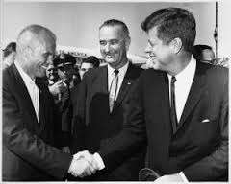
Vice-President for JFK (Kennedy)
After Kennedy is assassinated, Johnson becomes president

Slide 3
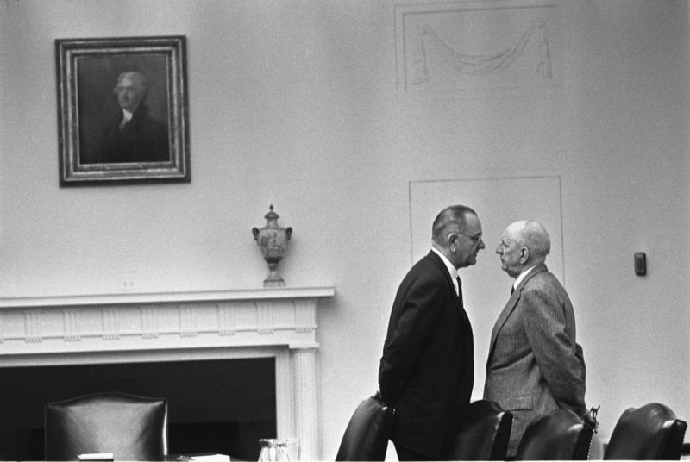
“The Treatment”

Slide 5
The Great Society
The Great Society Program had its roots in the New Deal
It sought to carry out the unfinished goals of the New Deal – universal health care, civil rights protections, etc.
Enhance American culture through Federal aid to the arts, sciences, and humanities.

Slide 6
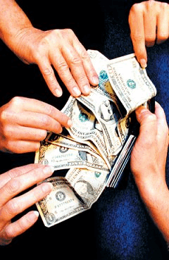
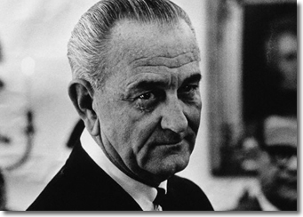
The Great Society
In his first State of the Union address, on January 8, 1964, President Johnson announced that his administration "today, here and now, declares unconditional war on poverty in America, and I urge this Congress and all Americans to join with me in that effort.“
Office of Economic Opportunity
Head Start
AFDC
Medicare
Medicaid

Slide 7
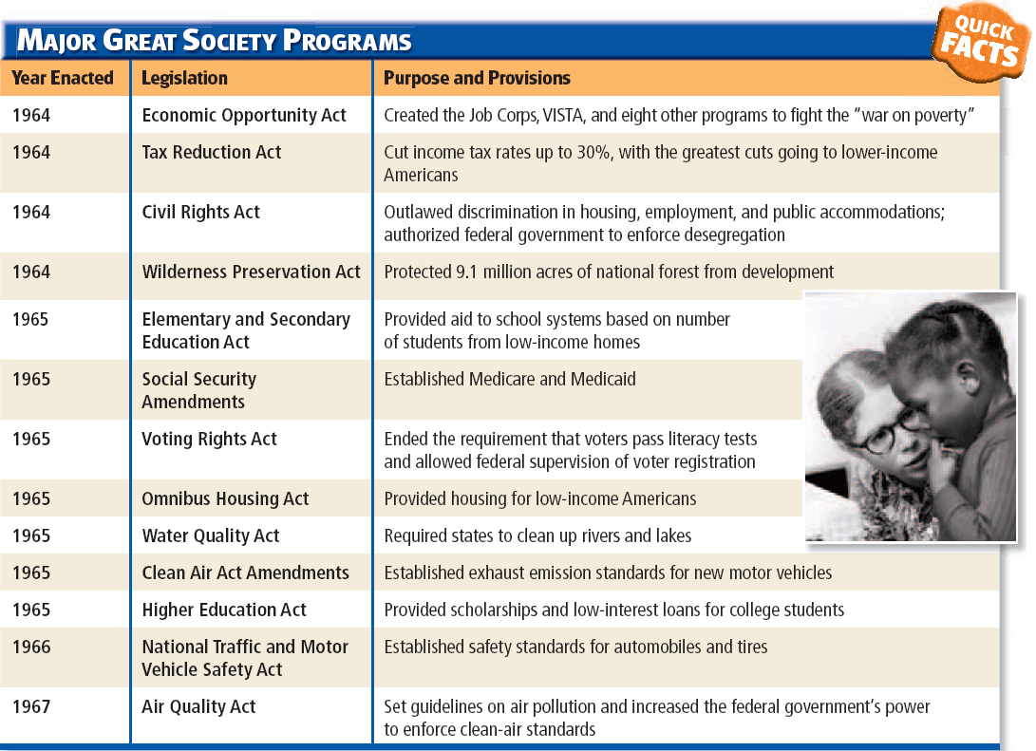

Slide 8
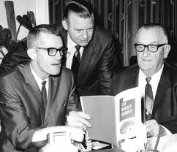
Office of Economic Opportunity
was the agency responsible for administering most of the “War on Poverty” programs.
Worked to create jobs and fight poverty.

Slide 9
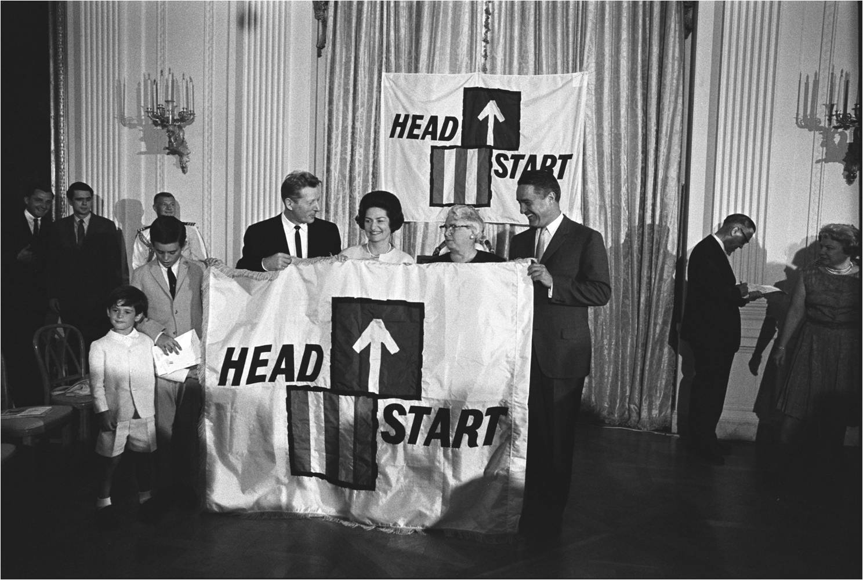
Head Start
Originally sought to prepare low-income children for schools by offering meals and other programs.

Slide 10
AFDC
Aid to Families with Dependent Children
Changed AFDC qualifications to include any household where there was no male family head present

Slide 11
Medicare
Medicare (Title XVIII) established to provide health insurance coverage to persons over age 65
Medicare is a government service that helps provide health care for senior citizens and disabled U.S. citizens.
Medicare part A: helps with hospital costs
Medicare part B: requires a monthly fee and helps pay for medical costs
Medicare part D: pays for prescription drugs

Slide 12
Medicaid
Medicaid (Title XIX) established to provide health insurance coverage to low income women and children (also, aged, blind and disabled)
In essence, Medicaid serves as the nation’s primary source of health insurance coverage for low-income populations. Each state administers its own Medicaid program

Slide 13
